Slide 1
Memory-safety Programming 内存安全程序设计

Slide 2
Content
Background
Memory-safety problems
Temporal memory problems：smart pointer
Spatial memory problems：dynamic bound checking

Slide 3
Taxonomy
时间类内存安全（Temporal safety caused by lifetime violation）
释放后使用（Use after free）
重复释放（Double free）
悬垂指针（Dangling pointer）
内存泄漏（Memory leak）
…
空间类内存安全（Spatial safety caused by wrong access）
缓冲区溢出（Buffer overflow）
解引用空指针（Null pointer dereferencing）
访问未初始化内存（Dereference uninitialized pointer）
…

Slide 4
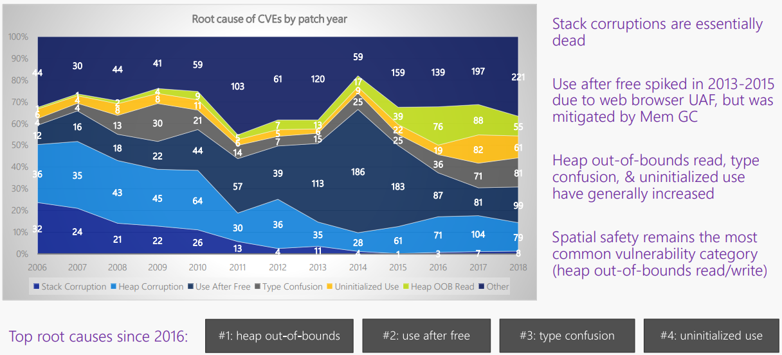
Spatial Memory Safety
图片源于Matt Miller
根据微软安全响应中心(MSRC)的报告，空间内存安全仍然为最常见安全类型。

Slide 5
Spatial Memory Safety
空间类内存安全（Spatial safety caused by wrong access）
缓冲区溢出（Buffer overflow）
解引用空指针（Null pointer dereferencing）
访问未初始化内存（Dereference uninitialized pointer）
…
如何从程序设计的角度防护
空间类内存安全问题？

Slide 6
Consensus on Spatial Memory Safety
针对空间类内存安全问题，动态校验必不可少
基于内存meta-data（base，bound）的动态校验
已有增强语言
Cyclone: fat pointer将bound信息进行封装，动态更新，访问时校验
SoftBound: fat pointer采用shadow memory实现，动态更新校验
Checked C: 增加annotation，静态更新bound信息，编译插入动态校验
Jim et al., Cyclone: A Type-Safe Dialect of C, ATC’02
Nagarakatte et al., Everything You Want to Know About Pointer-Based Checking, SNAPL’15
Elliott et al., Checked C: Making C Safe by Extension, SDC’18

Slide 7
Fat-pointer
p = malloc(size);
p_ base = p;
p_bound = (p!=0)?(p+size):0;
if (p < p_base || p >= p_bound)
raise exception();
*p = … or … = *p;

Slide 8
Fat-pointer
p = malloc(size);
p_ base = p;
p_bound = (p!=0)?(p+size):0;
if (p < p_base || p >= p_bound)
raise exception();
*p = … or … = *p;
p
…
p_base
…
p_bound

Slide 9
Fat-pointer
p = malloc(size);
p_ base = p;
p_bound = (p!=0)?(p+size):0;
if (p < p_base || p >= p_bound)
raise exception();
*p = … or … = *p;
p
…
p_base
…
p_bound

Slide 10
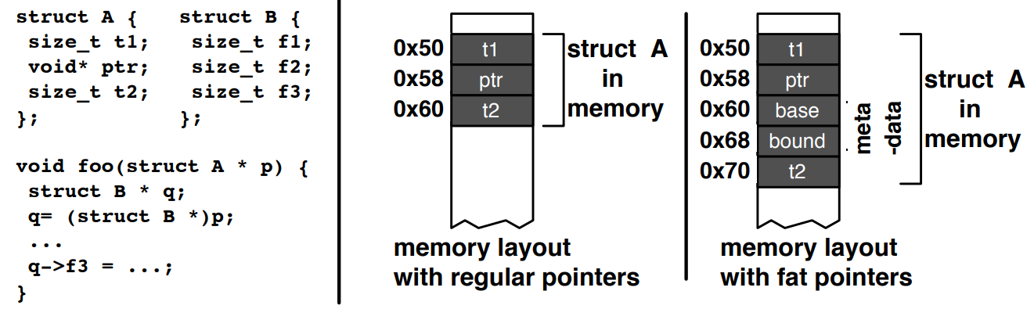
Meta-data Storage
近指针存储方式，导致memory layout的修改，
影响兼容性
Nagarakatte et al., Everything You Want to Know About Pointer-Based Checking, SNAPL’15

Slide 11
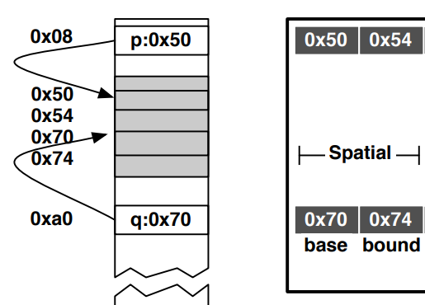

Meta-data Storage: Disjoint Space
不同实现方式：
shadow space
(a linear region of memory)
a hash table
a trie data structure
Nagarakatte et al., Everything You Want to Know About Pointer-Based Checking, SNAPL’15

Slide 12
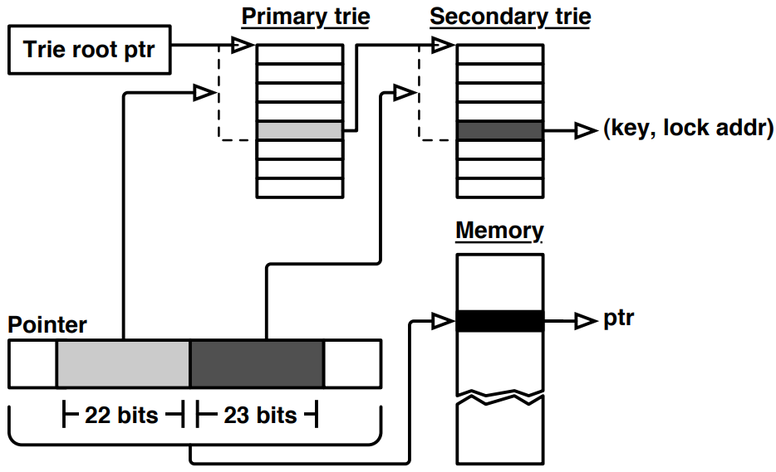
Meta-data Storage: Disjoint Space
Trie data structure for meta-data
Nagarakatte et al., CETS: Compiler-Enforced Temporal Safety for C, ISMM’10

Slide 13
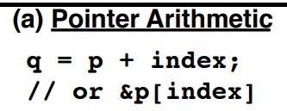
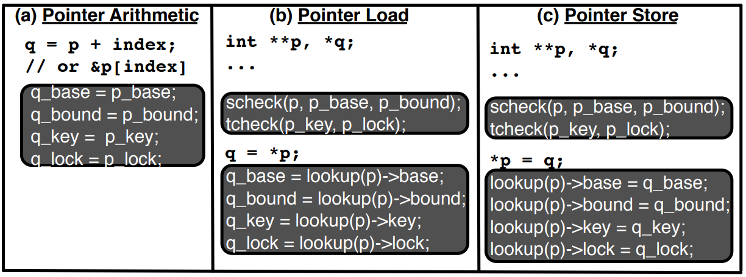
Meta-data Update
Nagarakatte et al., Everything You Want to Know About Pointer-Based Checking, SNAPL’15

Slide 14
Runtime Overhead
 | 空间开销 | 时间开销
Cyclone | - | 3.05x
SoftBound | 64%-87% | 2.73x
空间开销
数据结构优化：hashtable、trie structure
硬件辅助：Intel MPX、ARM MTE
时间开销
基于人工标注，消减meta-data维护开销
基于程序分析技术，消减动态check数量
基于并行加速，提高check效率
基于专用硬件指令，提高执行效率

Slide 15
Manual Annotation
_Array_ptr<int> p : bounds(p, p + len)
Range Bounds p : bounds(e1, e2)
Only memory at or above e1, and below e2 can be accessed via pointer p
Count Bounds p : count(e1)
Only memory at or above p, and below p + e1 can be accessed via pointer p
Elliott et al., Checked C: Making C Safe by Extension, SDC’18

Slide 16
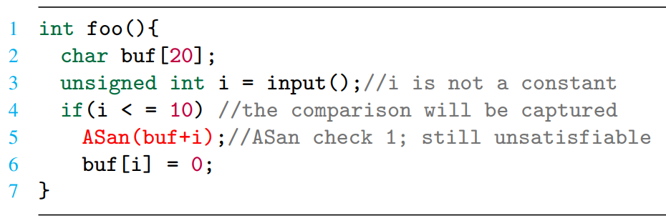
Program Analysis
Removing Unsatisfiable Checks
Zhang et al., Debloating Address Sanitizer, Security’22

Slide 17
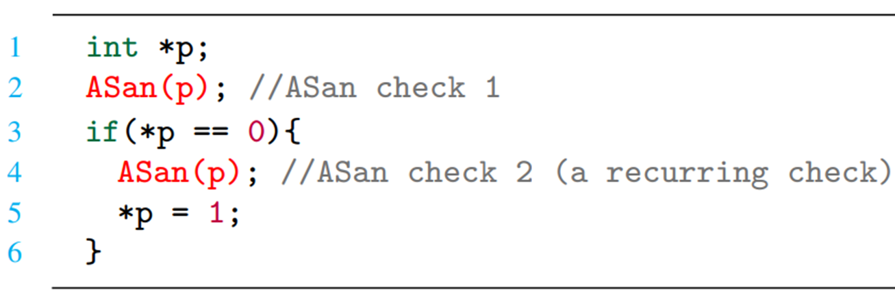
Program Analysis
Removing Unsatisfiable Checks
Removing Recurring Checks
Zhang et al., Debloating Address Sanitizer, Security’22

Slide 18
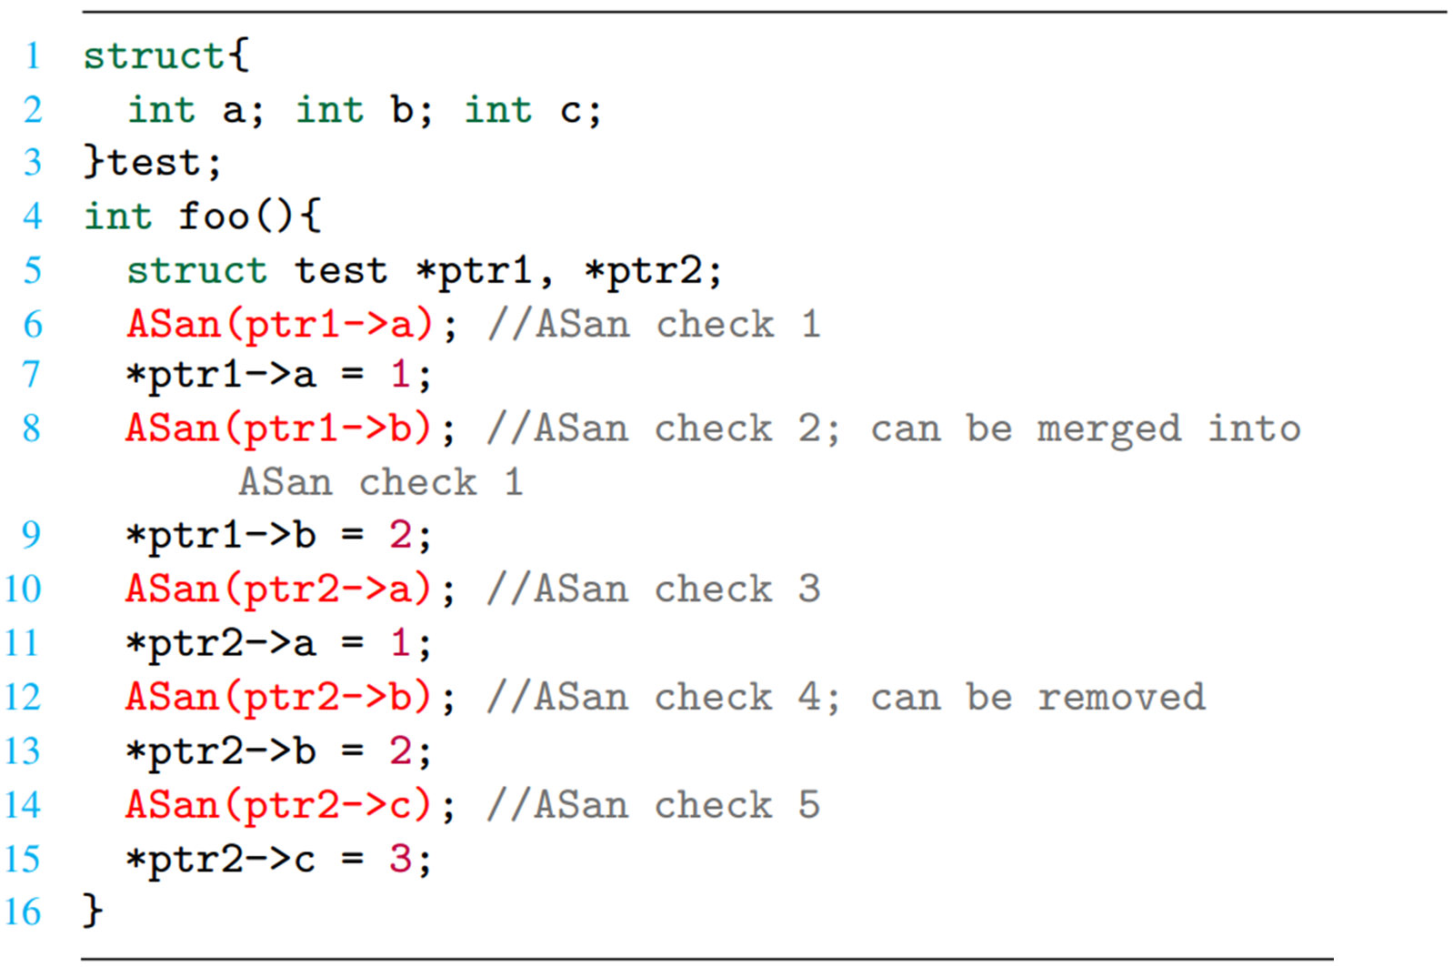
Program Analysis
Removing Unsatisfiable Checks
Removing Recurring Checks
Optimizing Neighbor Checks
Zhang et al., Debloating Address Sanitizer, Security’22

Slide 19
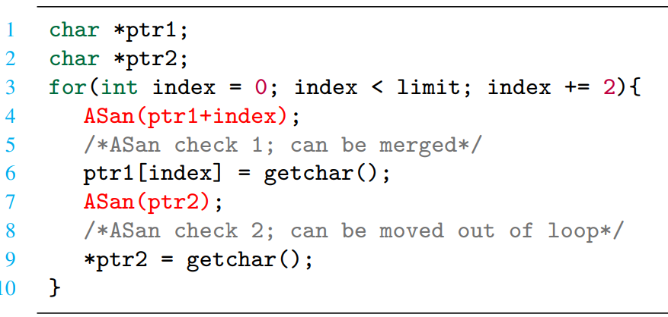
Program Analysis
Removing Unsatisfiable Checks
Removing Recurring Checks
Optimizing Neighbor Checks
Optimizing Checks in Loops
Zhang et al., Debloating Address Sanitizer, Security’22

Slide 20
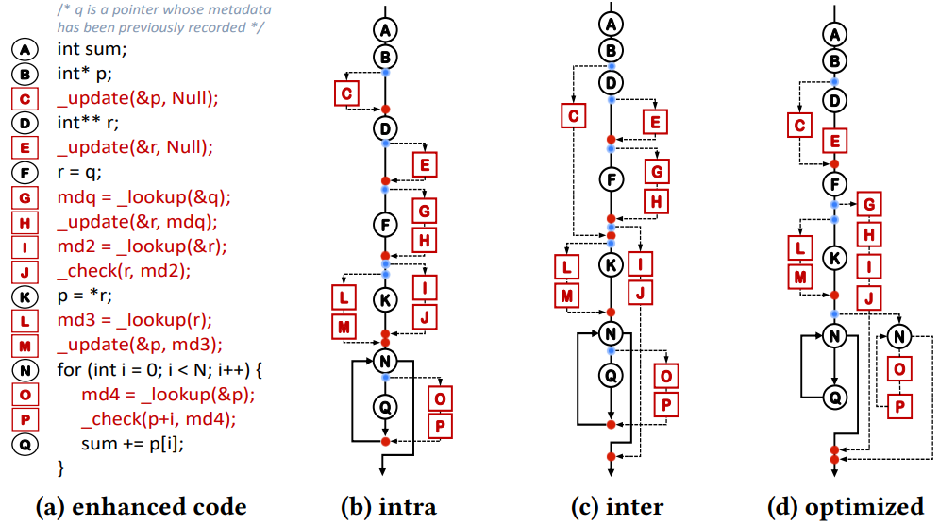
Parallel Acceleration
Zhang et al., Catamaran: Low-Overhead Memory Safety Enforcement via Parallel Acceleration, ISSTA’23

